Slide 1
Growing Through Mentorship
Deborah Jackson, LICSW
Associate Director of Training and Consultation - JRI

Slide 2
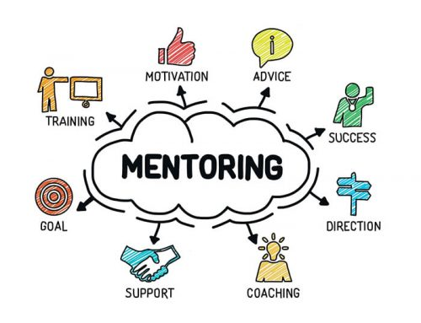
What is Mentorship
Mentorship (noun)
  The guidance provided by a mentor, especially an experienced person in a company or educational institution
  A period of time during which a person receives guidance from a mentor
A mentor may share with a mentee (or protégé) information about his or her own career path, as well as provide guidance, motivation, emotional support and role modeling. A mentor may help with exploring careers, setting goals, developing contacts, and identifying resources – from Washington.edu

Slide 3
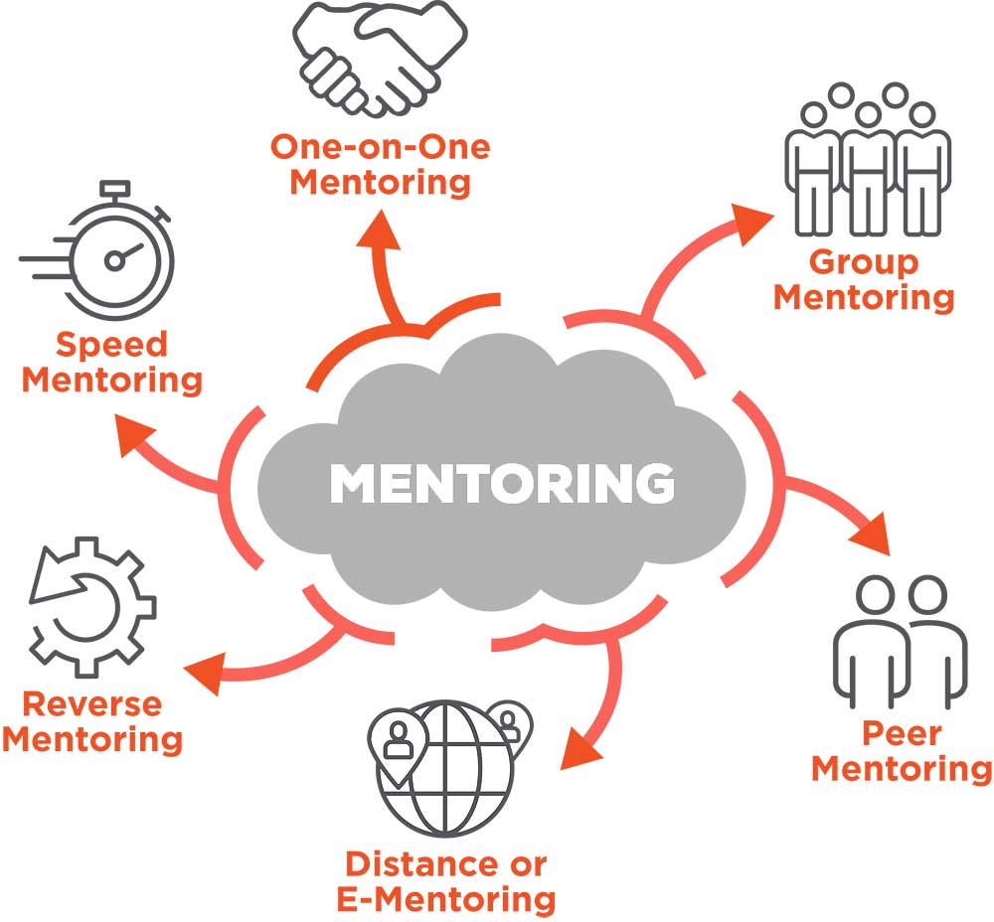
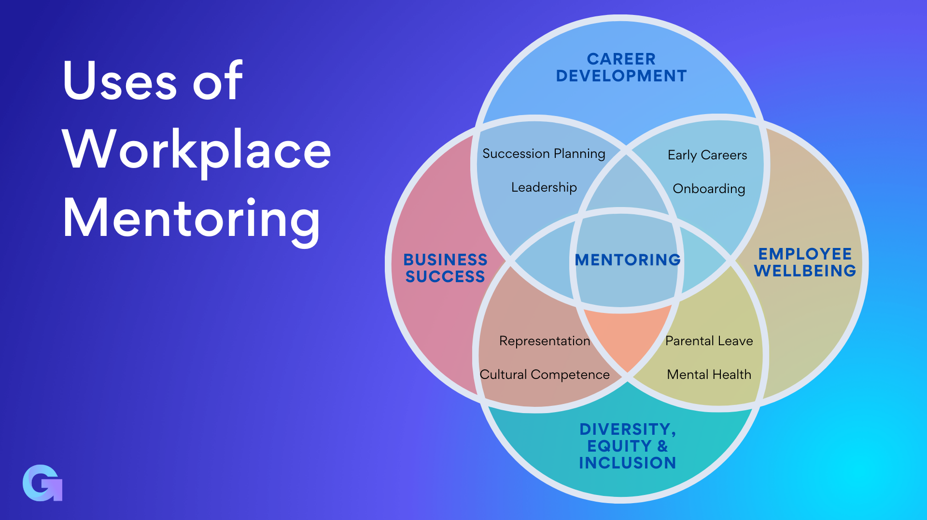
Types of Mentorship

Slide 4
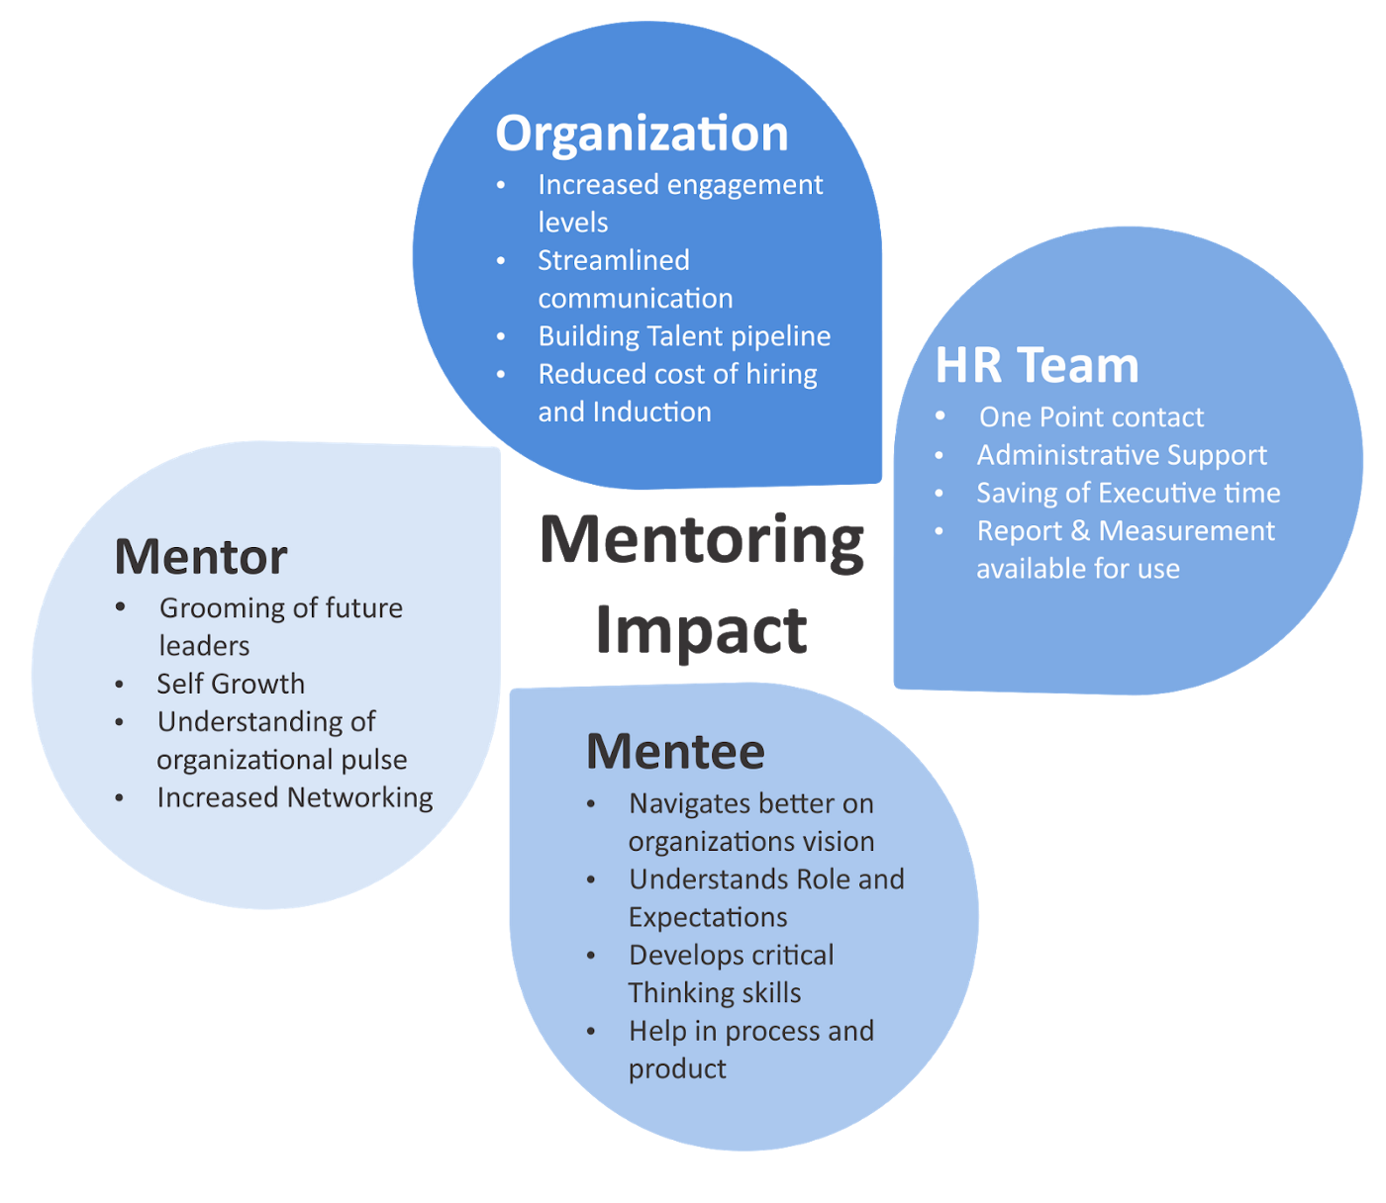
Benefits of Mentorship
Reduces staff turnover (50% higher retention rate)
Increases connection between Staff and with the agency
Increases collaboration
Increases learning opportunities
Increases accountability
Builds leadership skills
Fosters resiliency and adaptability

Slide 5
Considerations for Mentorship
Formal or informal
Time-limited or open ended
Self selected or nominated
Skills or position matched
There are many considerations for running a mentorship program
Implementation is aided by consistency in standards and protocols
Different attributes will benefit different programs and/or participants

Slide 6
JRI Mentorship Program
Formal
Time-limited
Self selected
Skills matched
Formal program for 6 months
Mentees (and some mentors) apply
Mentees specify skills and characteristics they desire in a mentor

Slide 7
Forms for Mentorship
JRI Mentee Application
JRI Mentor Application
Mentorship Check In Form
Keep records around participants
Do periodic check-ins
Consider alternative/additional resources
Continue improvements

Slide 8
Q & A
How else can I help?

